Slide 1

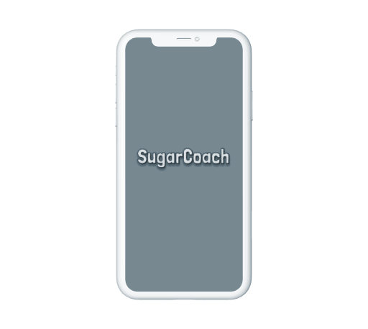
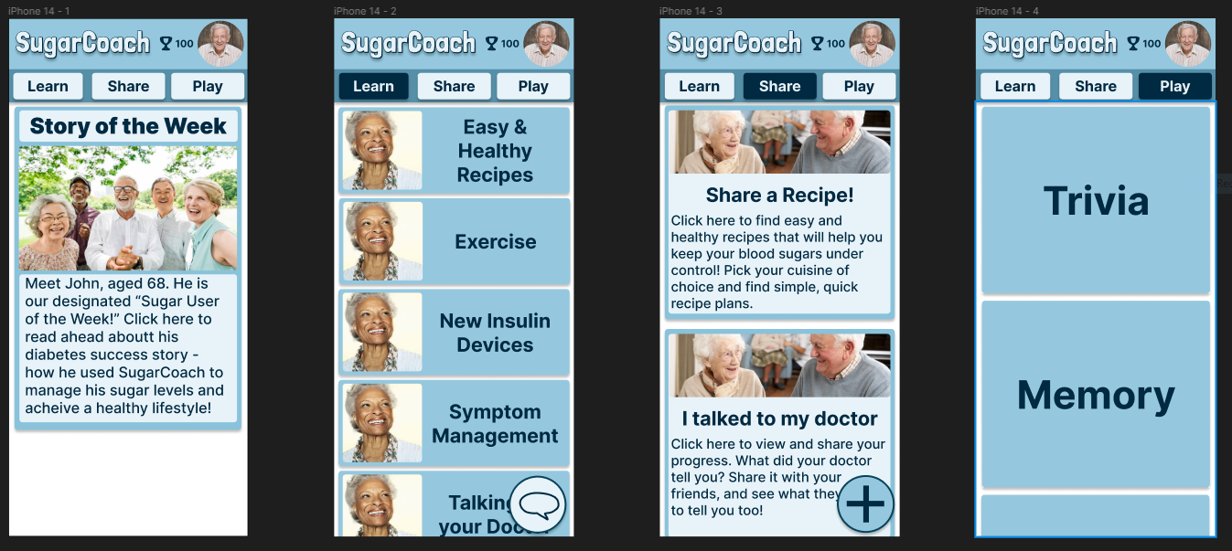
SugarCoach
Application for the elderly with
diabetes with low health literacy
Team 4
Divya, Jessie, Preksha
Mark, Matt, Mohammad
Notes:
So what is the rationale behind that?

Slide 2

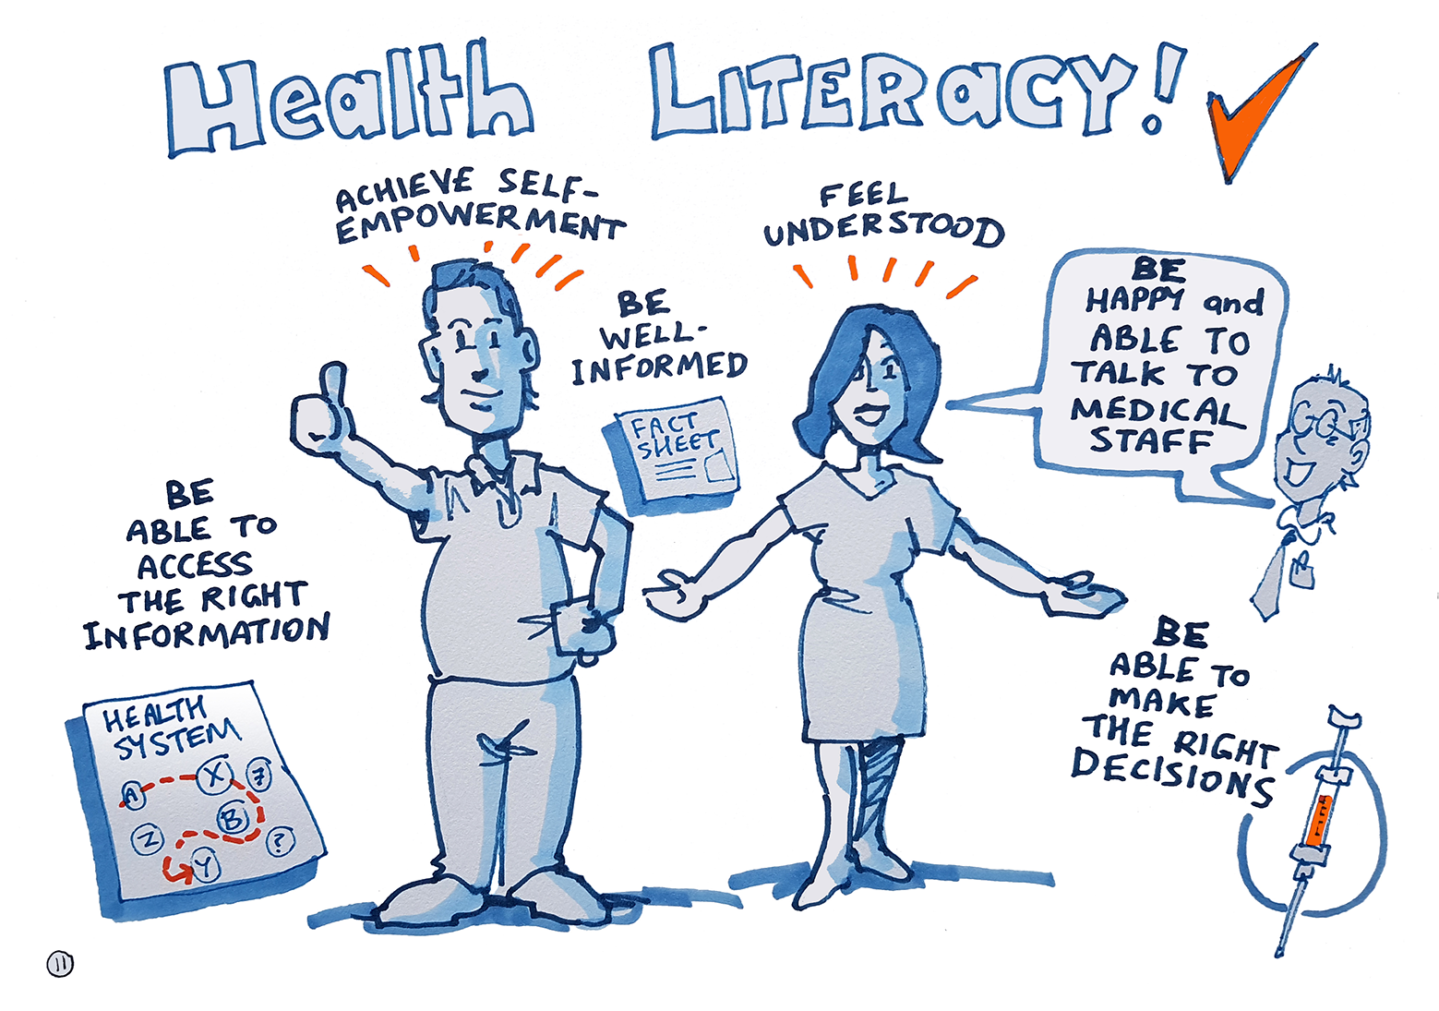
What is health literacy?
And why is it important?
Notes:
Personal health literacy is the degree to which individuals have the ability to find, understand, and use information and services to make informed health related decisions and actions for themselves and others. Why is it important?? It gives you the power to control your health.

Slide 3
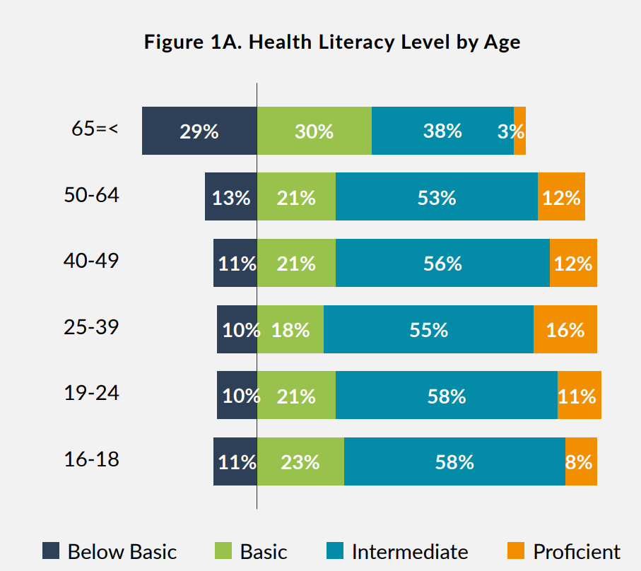
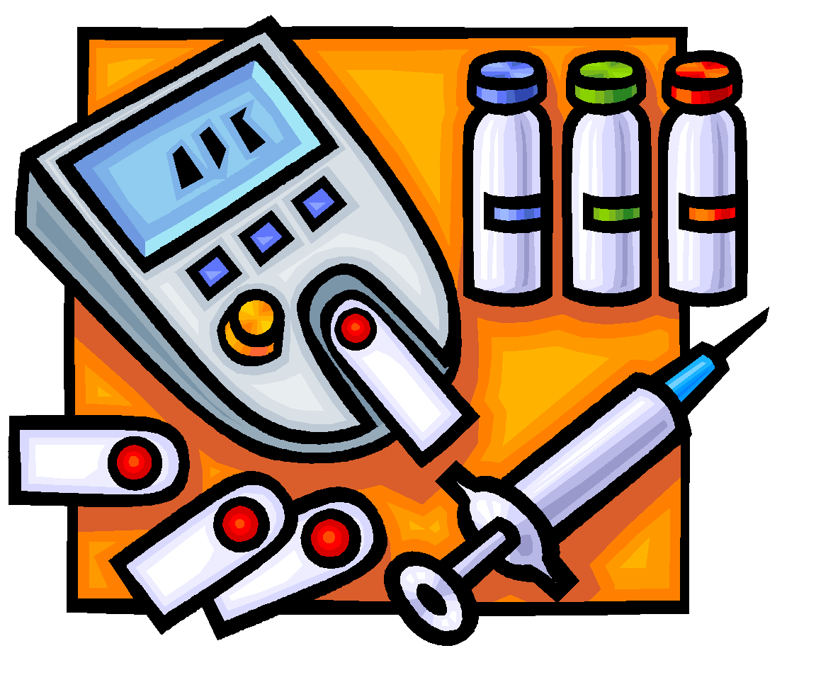
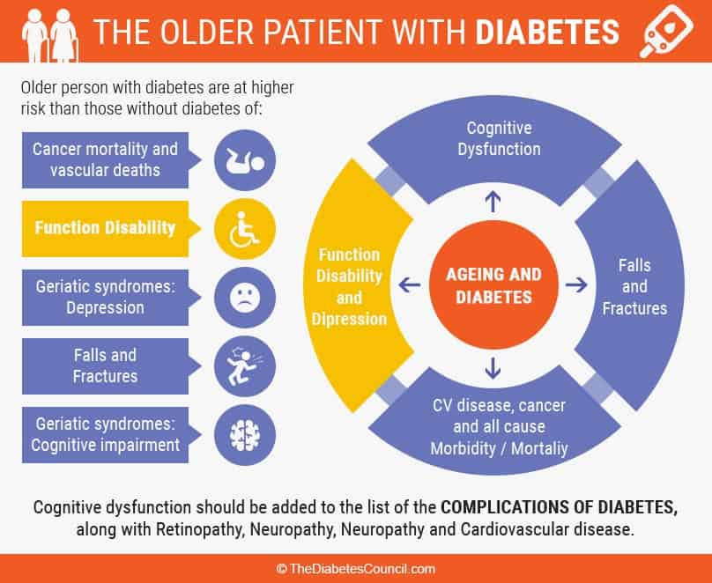
Elderly adults with low health literacy with diabetes
Notes:
This shows that they represents individuals who have the most to do with health literacy. But let us hop over to Figure1 a.

Slide 4
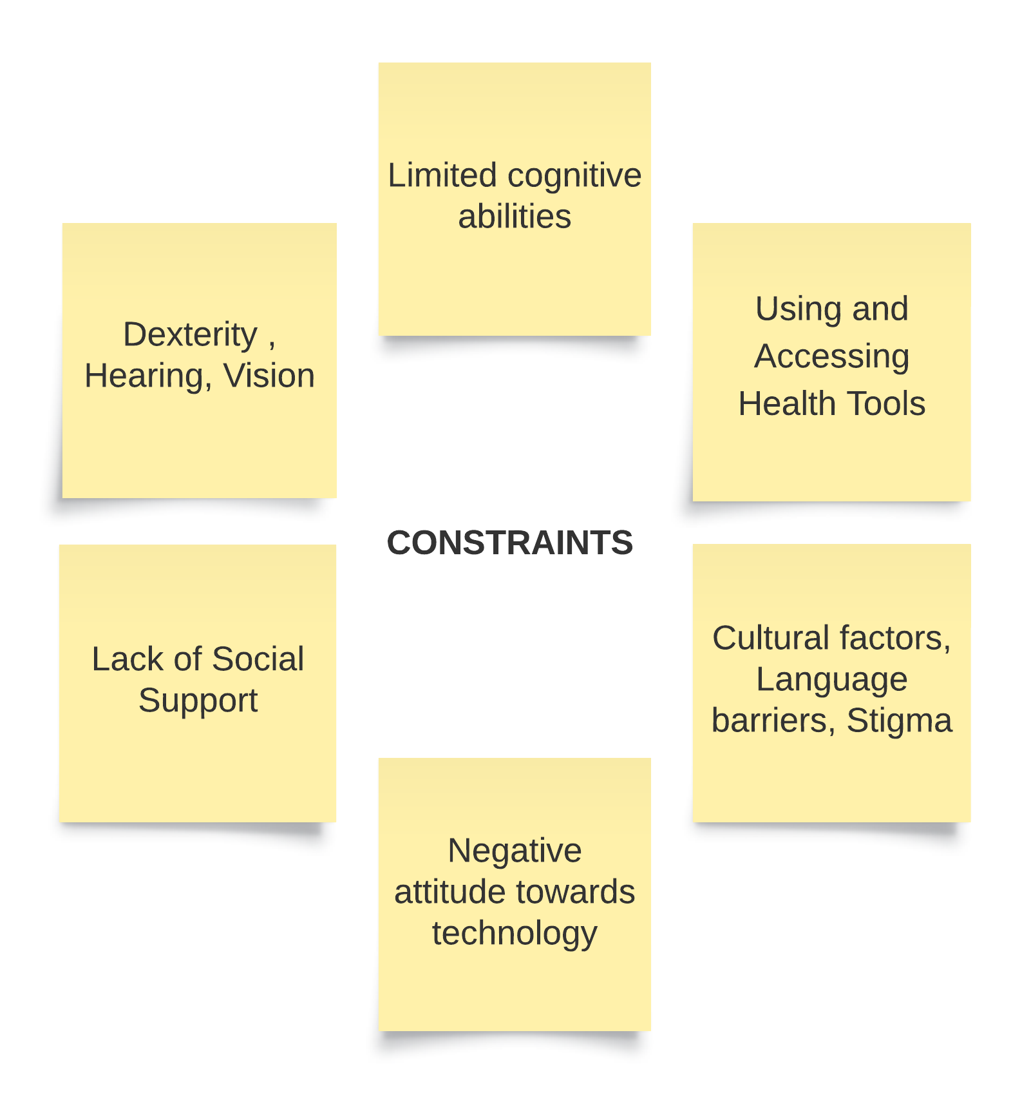
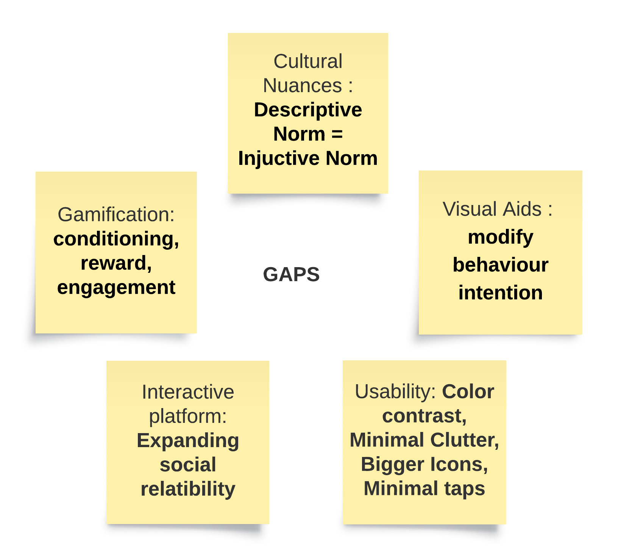
Notes:
Constraints and tradeoffs??
The gaps and concepts we are focusing on are : Lack of cultural nuances. over here we take into account cultural practices, dietary habits. We want the descriptive norms to be in parallel with the injunctive norm.

Slide 5
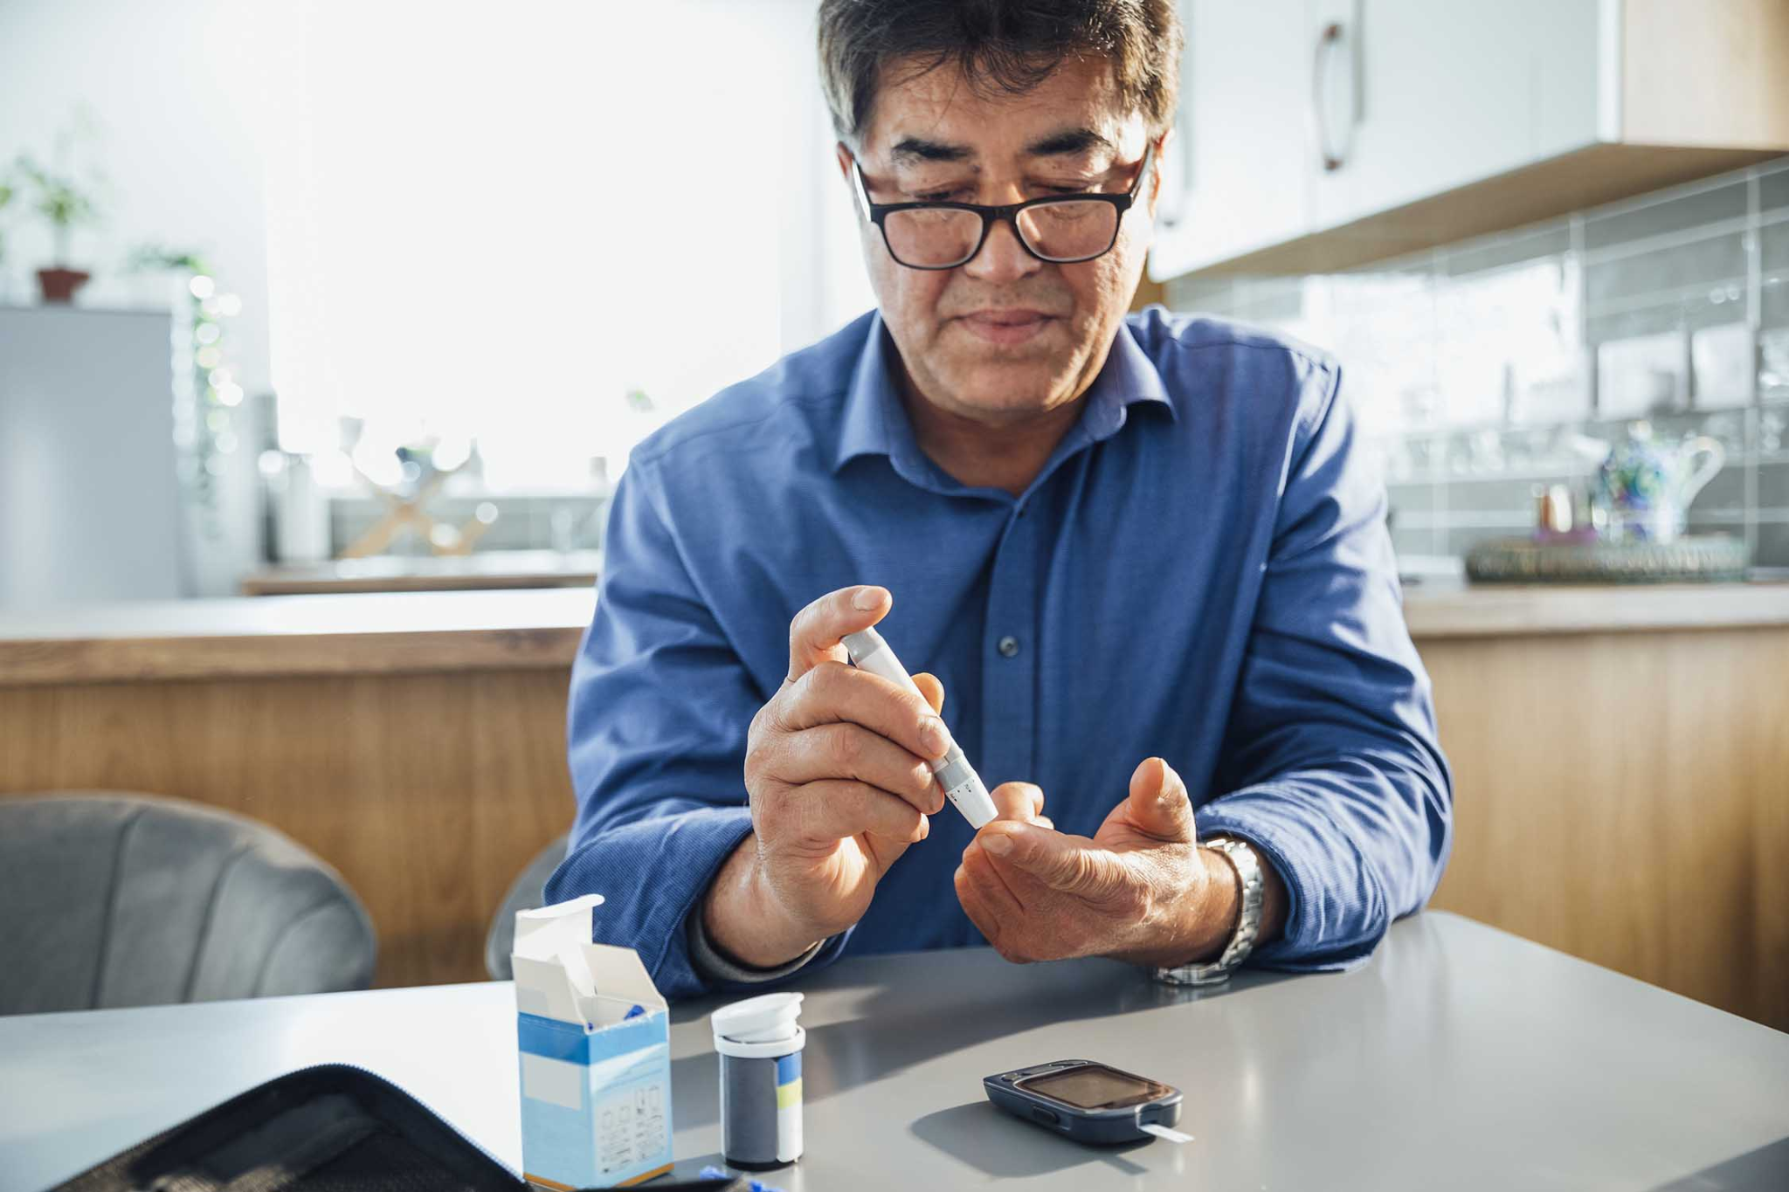
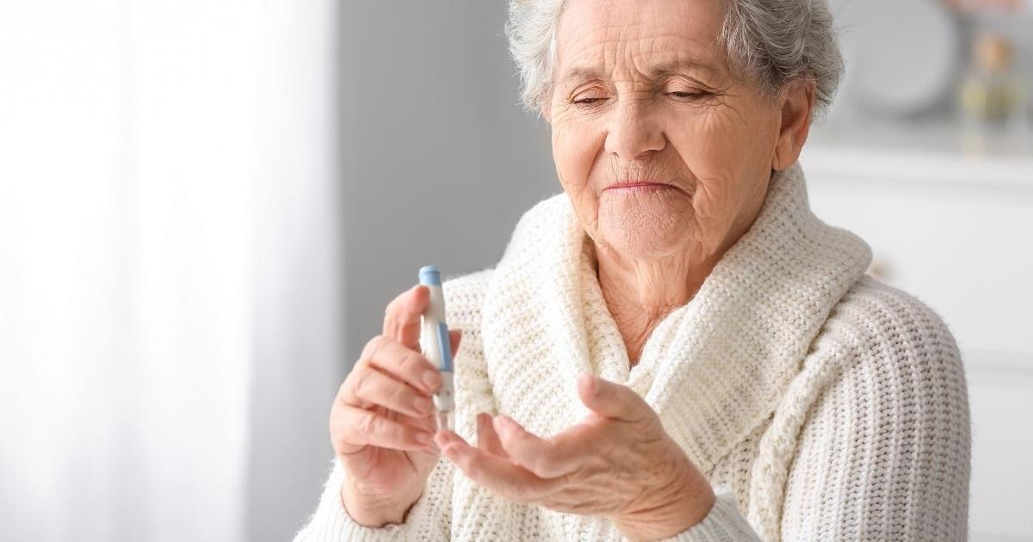
Persona 1
James
Persona 2
Dabby
Background:
67 years old, Hispanic
Technology access: Smart Phone, iPad, Laptop
Literacy: high
Experience with diabetes diet restriction: <1 year
Language: English and Spanish
Background:
79 years old, White
Technology access: Smart Phone
Literacy: medium
Experience with diabetes diet restriction: ~15 year
Language: English
Low Technology Use
High Technology Use
Low Technology Use
High Technology Use
Low Health Literacy (Diabetes)
High Health Literacy
Low Health Literacy (Diabetes)
High Health Literacy
Low Health Literacy Skills
High Health Literacy Skills
Low Health Literacy Skills
High Health Literacy Skills
Narrative:
James is diagnosed with diabetes 6 months ago and finds it hard to manage complex diet plan daily to meet the doctor’s instruction for his diabetes condition. He is not entirely sure often feels not able to enjoy his meal or enjoy dinner parties with friends and meet his diet requirement in the meantime..
Narrative:
Dabby has about 15 years of diabetes and this is getting harder and harder to to follow the instructions for their long-term diabetes condition. She has tried several folk remedy during the process since she is so fatigued about her diabetes condition. As her condition turned worse in her last doctor’s appointment, she started to try a new medication and want to know how other people’s experience about this new treatment.
Needs & User Goals:
Putting his dietary requirements into practice
Manage diet plan on his own
Understand and track his daily nutrition intake
Pain points & Frustrations
Not confident about his own ability to manage doctor’s instruction such as daily diet, medicine intake, and nutrition restrictions.
Frustrated about managing diet plan and enjoy food with family and friends
Needs & User Goals:
Accountable information source
Emotional support
Pain points & Frustrations
Prompt help for both emotional support, health information, and new treatment are needed
Lose patience of personal diabetes condition

Slide 6
Behavior Change Theories
Visual Aids and Clear Communication
Text to voice
Visual information rather than heavy-text 4.1
Social Support
Community-based forum 3.3
Gamification
Tracker and reward system 10.10/16.2

Slide 7
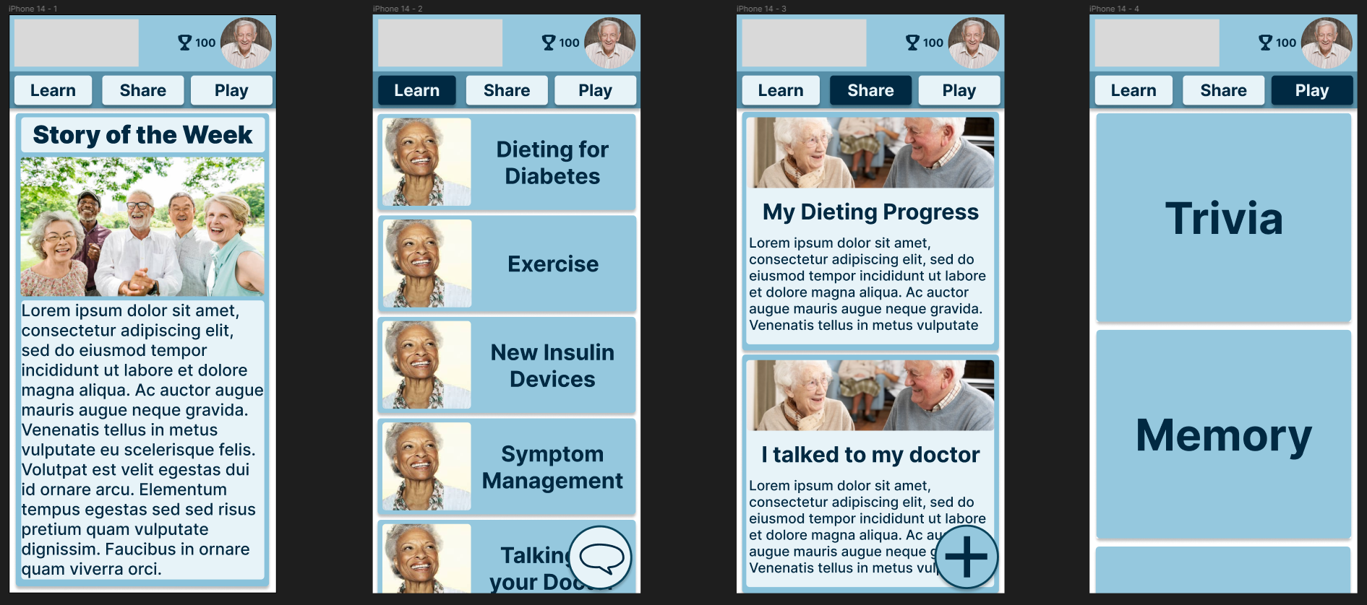
Features Mockup
Notes:
Dont forget to mention design constraints
I wont :)
Gamification is limited by complexity due to the population being older and likely not being able to use complex game mechanics Trade off with community based information sharing can create social support at the cost of potential spread of misinformation

Slide 8
THANK YOU!
QUESTIONS?

Slide 9
REFERENCES
Lopez, C., Kim, B., & Sacks, K. (2022). HEALTH LITERACY IN THE UNITED STATES Enhancing Assessments and Reducing Disparities. https://milkeninstitute.org/sites/default/files/2022-05/Health_Literacy_United_States_Final_Report.pdf
Wang X, Luan W. Research progress on digital health literacy of older adults: A scoping review. Front Public Health. 2022 Aug 5;10:906089. doi: 10.3389/fpubh.2022.906089. PMID: 35991040; PMCID: PMC9389004.
https://umich.instructure.com/courses/585368/files/folder/Class%20Schedule%20Materials/Class%203-%20January%2018/Lecture%20Materials?preview=30230078&wrap=1

